Slide 1

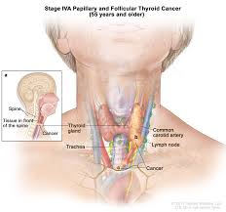
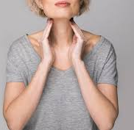
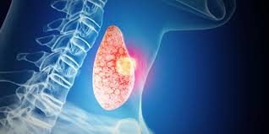
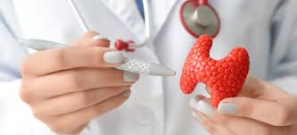
Thyroid Cancer Recurrence Prediction using Deep Learning"
Presented by – Aritra Mukherjee
ID: UMIP270247
Machine Learning Intern
At - Unified Mentor Pvt. Limited
Aritra Mukherjee

Slide 2
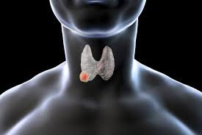
Introduction To Project –
Thyroid Cancer
Thyroid cancer is a significant health issue worldwide.
Predicting recurrence can help doctors design better treatment plans.
Our solution uses machine learning to support early prediction based on patient data.
Aritra Mukherjee

Slide 3

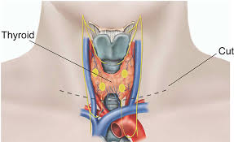
GOAL
To build an AI-based system that predicts the likelihood of thyroid cancer recurrence.
Design an end-to-end ML pipeline (from preprocessing to prediction).
Deploy the model using Streamlit for interactive usage by clinicians or researchers.
Aritra Mukherjee

Slide 4
Dataset Overview for Classification
Collected from a historical thyroid cancer patient dataset – Given By Company Unified Mentor.
Target Variable:
Recurrence (Yes / No)
Features:
Demographic: Age, Gender
Lifestyle & History: Smoking, Radiotherapy
Clinical: Pathology, Thyroid Function, TNM staging, etc.
Class Imbalance Present (handled using SMOTE)
Aritra Mukherjee

Slide 5
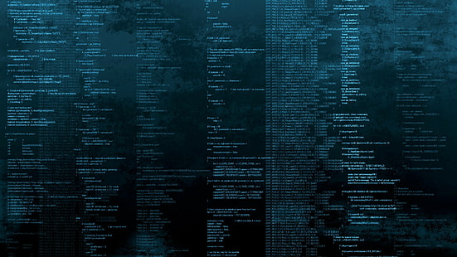
Tech Stack
Technologies & Tools Used
Layer | Tools Used
Language | Python
Data Handling | Pandas, NumPy
ML / DL | Scikit-learn, TensorFlow / Keras
Preprocessing | ColumnTransformer, Pipeline, SMOTE
Deployment | Streamlit
Model Storage | Pickle (.pkl), Keras (.h5)
Aritra Mukherjee

Slide 6
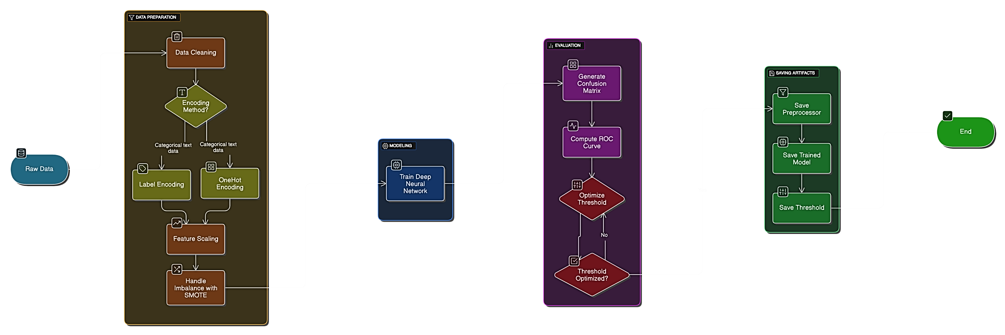
Workflow Pipeline

Slide 7
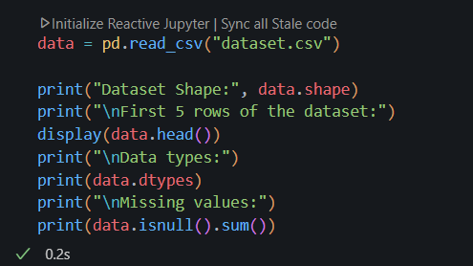
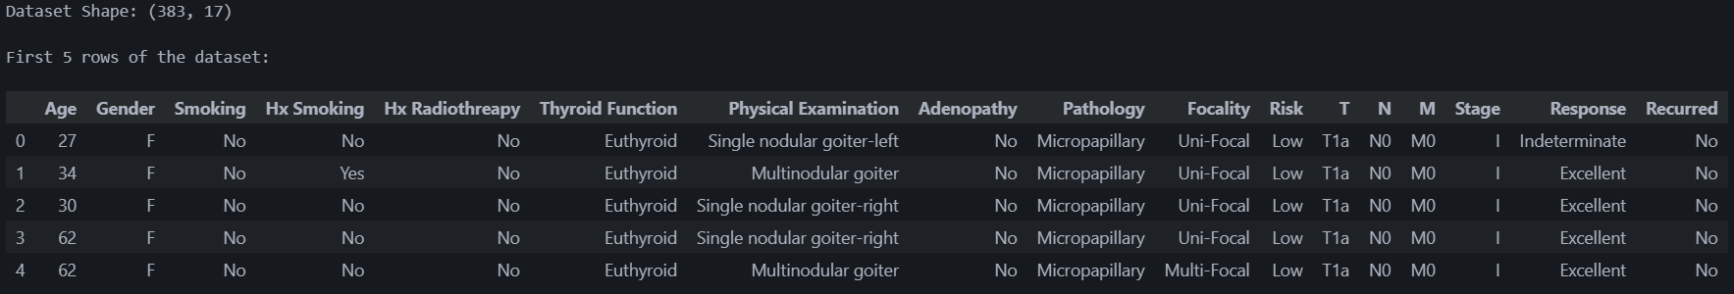
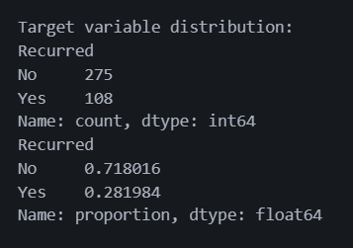
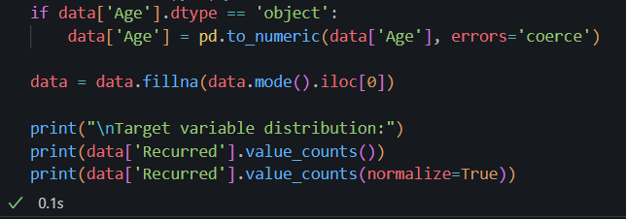
Load Dataset and Display Basic Info
Data Preprocessing
Aritra Mukherjee

Slide 8
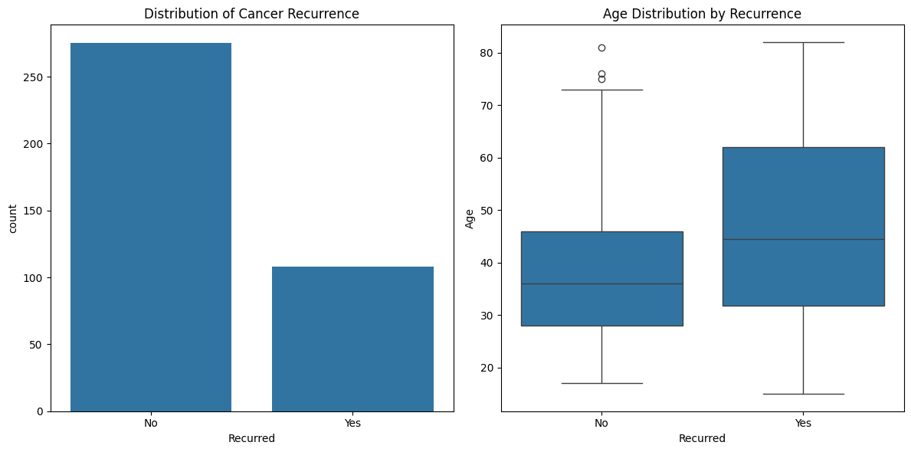
Data Visualization
Aritra Mukherjee

Slide 9
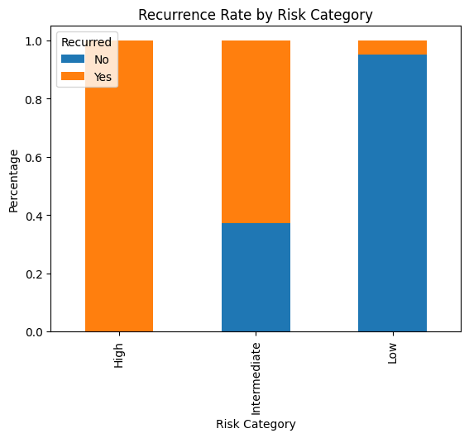
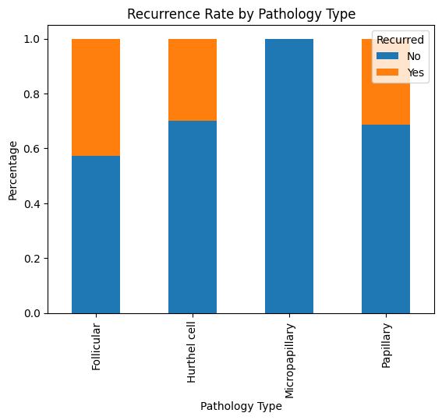
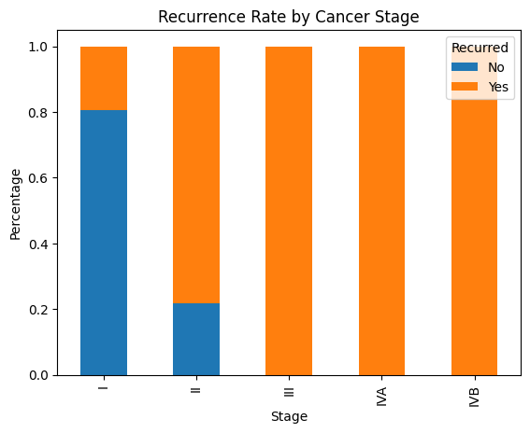
Data Visualization

Slide 10
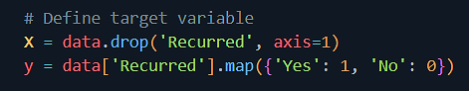
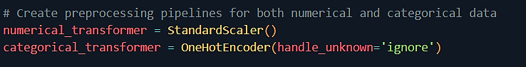
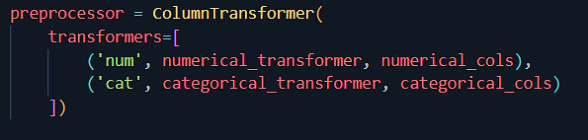
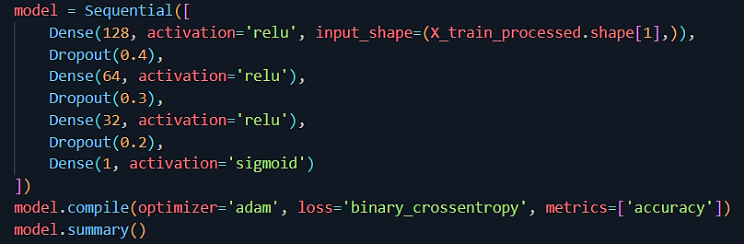
Feature Engineering
(Preprocessing + SMOTE)
Model Architecture
Aritra Mukherjee

Slide 11
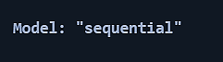
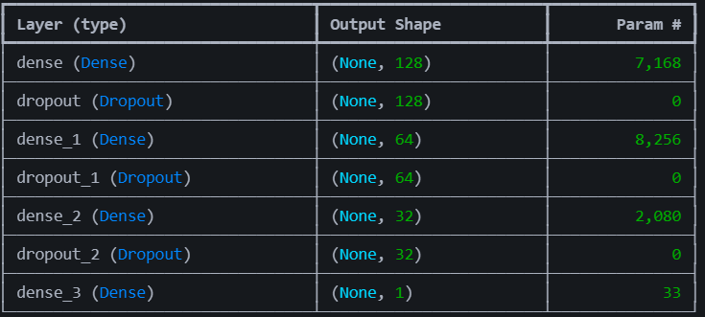
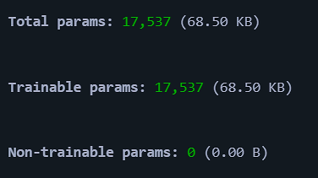
Model Architecture

Slide 12
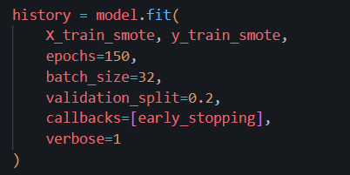
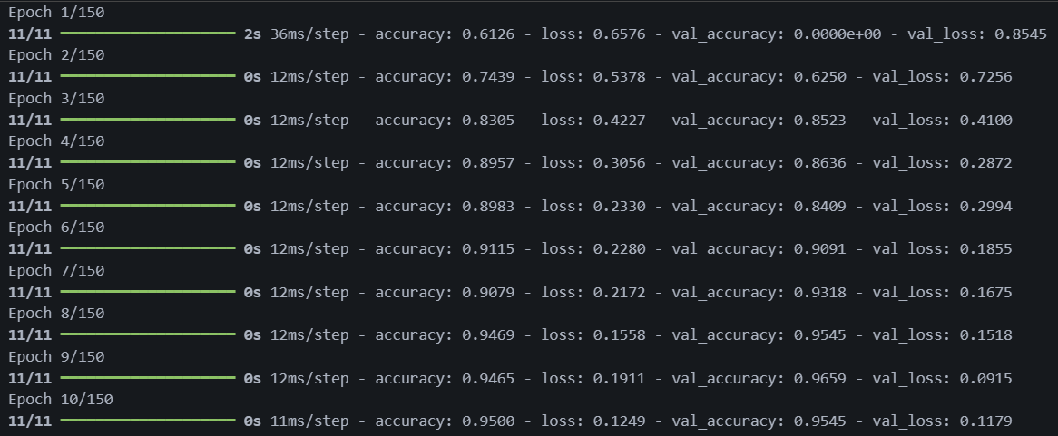
Use Early stopping to prevent overfitting
Train the Model For 150 Epochs
It’s stop at 65 by getting 99% accuracy
. . .
Accuracy – 99%

Slide 13
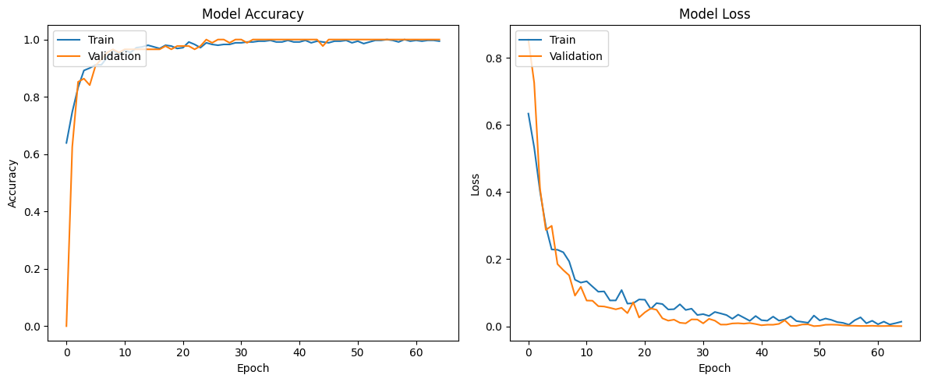
Evaluate the Model
Aritra Mukherjee

Slide 14
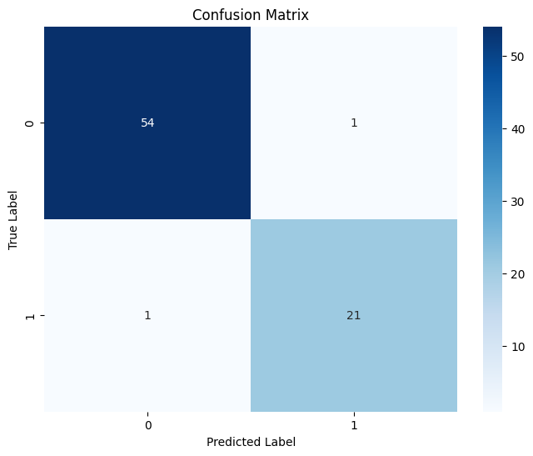
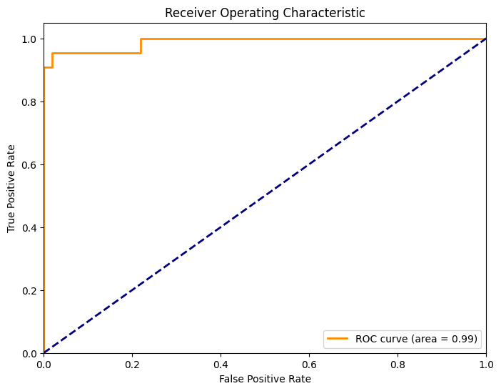
Save the Model
Aritra Mukherjee

Slide 15
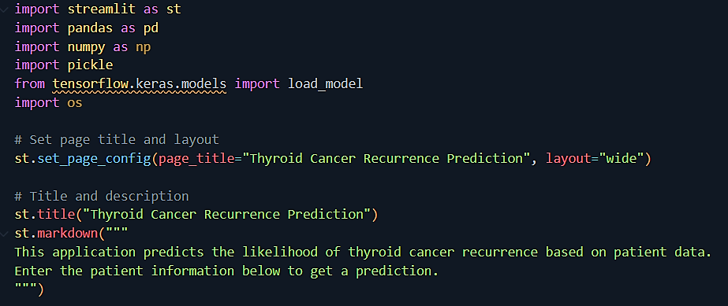
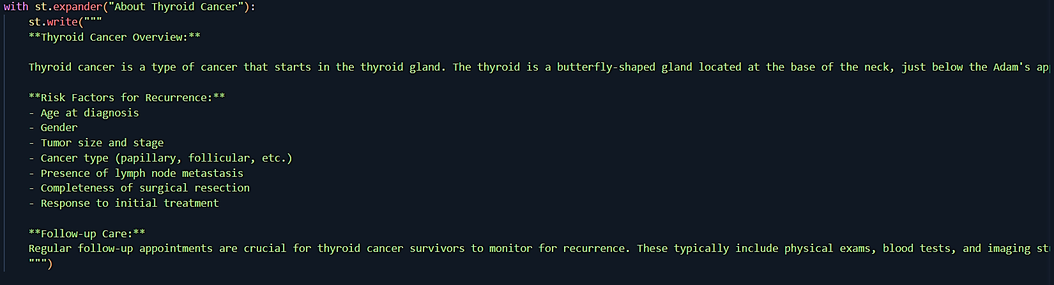
UI CODE
. . .
Aritra Mukherjee

Slide 16
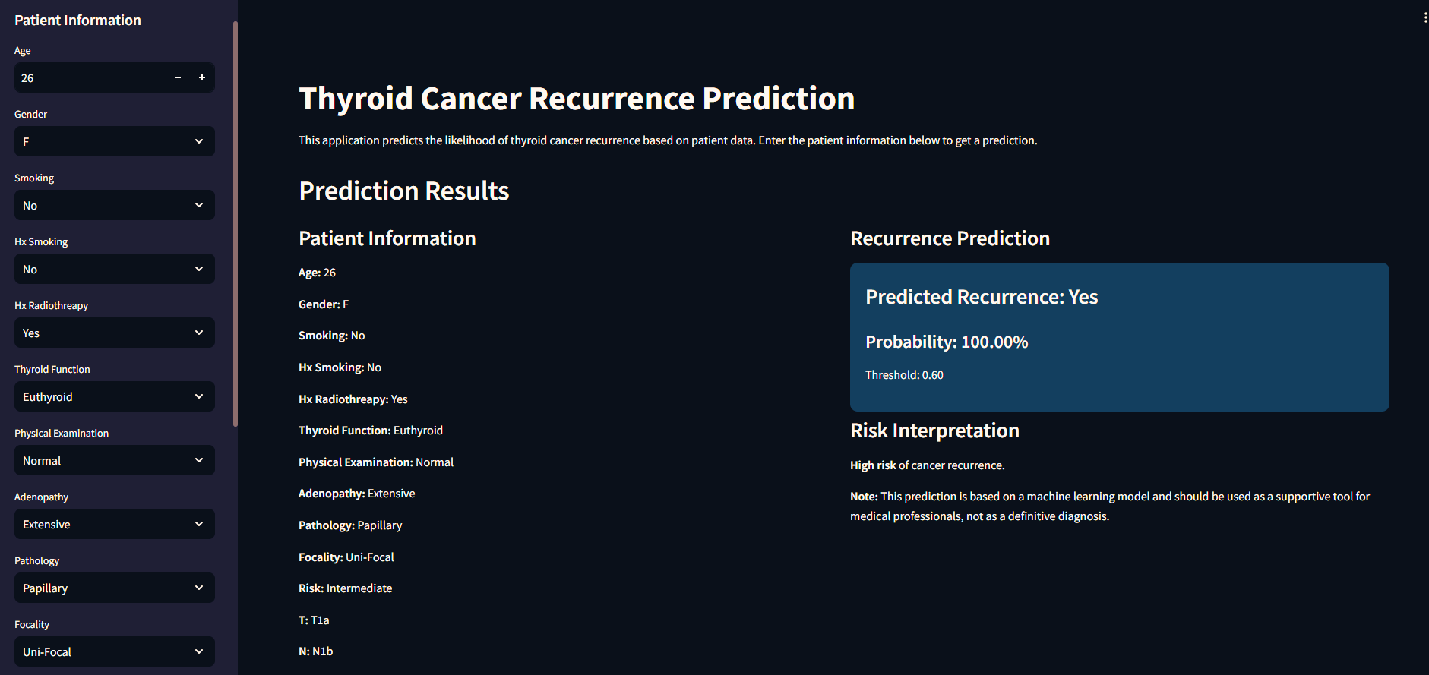
Prediction
Aritra Mukherjee

Slide 17
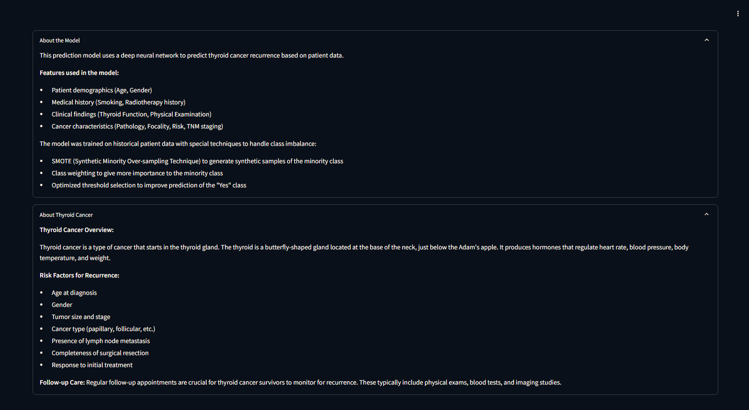
Prediction

Slide 18
GitHub Repo-
Thyroid-Cancer-Detect-APP
Aritra Mukherjee

Slide 19
Conclusion
Successfully built an AI model for thyroid cancer recurrence.
Handled imbalanced data using SMOTE and class weighting.
Deployed as a Streamlit web app for real-world usability.
Can serve as a supportive tool for medical professionals.
Aritra Mukherjee

